Slide 1

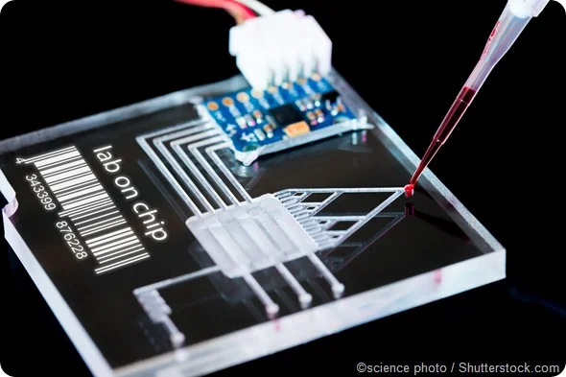

Final Presentation
Interdigitated Electrodes in Microfluidics
Erin Ingram & Omar Mahmood
Faculty: Dr. Arum Han, Dr. Han Zhang
NanoBio Systems Lab
Notes:
Erin

Slide 2
Problem Statement & Solution
Satellite droplets form during droplet generation
Design a two stage filtration system incorporating an Interdigitated Electrode (IDE) arrays to perform size based filtration and prevent satellite droplets from making it to the chip’s output
Electrodes
Fluid flow
Notes:
Erin

Slide 3
Subsystems and Interface
Satellite droplet
Channel - Fabricated by Omar
IDE- Fabricated by Omar
Droplet
PCR
Desired droplets
Satellite droplets - “waste”
Channel - Fabricated by Erin
IDE - Fabricated by Erin
Various droplet sizes
1
2
1- Droplets not big enough - “Waste”
2- Droplets too big - “Waste”
3- Perfect size
3
Final Droplets
Notes:
Both

Slide 4
Engineering Design Accomplishments
DESIGN | Omar | Erin
Channel | ✅ | ✅
IDE | ✅ | ✅
FABRICATION | Omar | Erin
Channel | ✅ | ✅
IDE | ✅ | ✅
Fabrication Steps:
Channel
3D print master mold
Softlithography to produce channel chips
Cut / hole punch
IDE
Order mask
Photolithography
Wet-etching
Silicon nitride deposition
Bond channel chips + IDEs
Plasma clean
Alignment
Solder wires onto IDE pads
Steps sometimes have to be repeated several times per each device produced.
Things go wrong in fabrication, and you just have to repeat!
Notes:
Erin

Slide 5
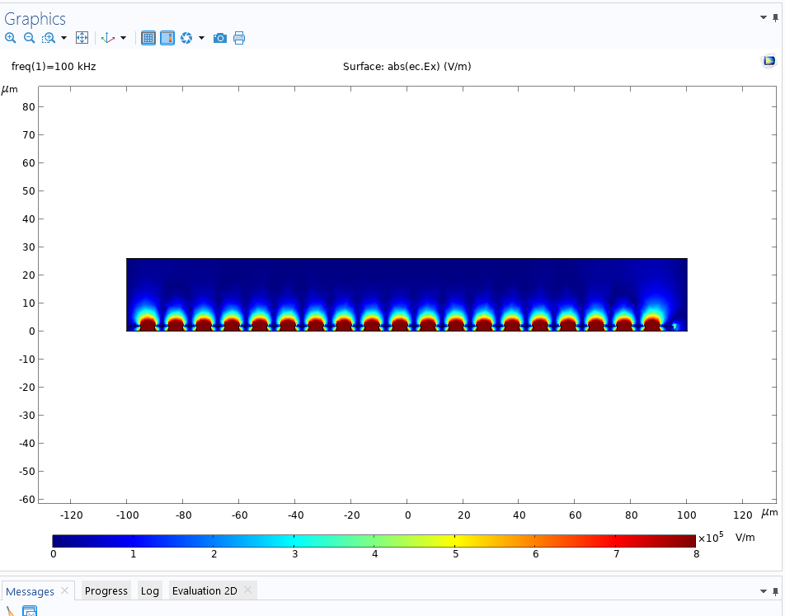
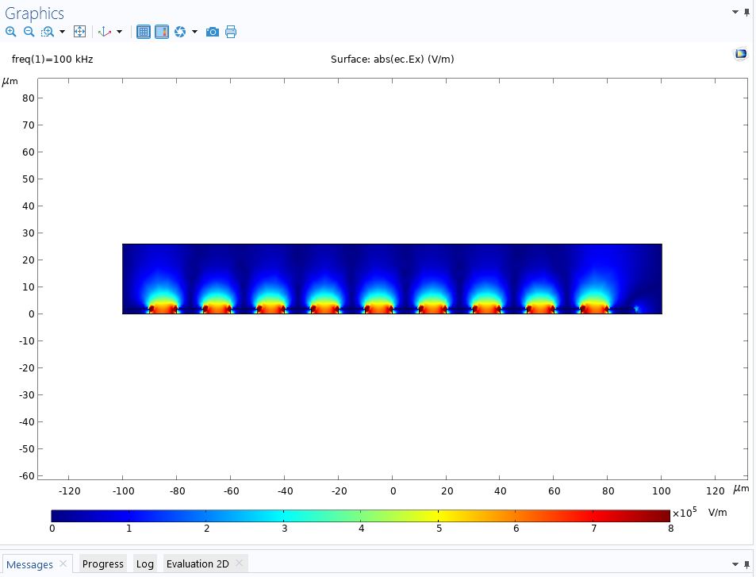

Electric Field Simulation Results
5 µm
10 µm
20 µm
Help us see what height/strength of E fields will reach the droplets passing through our channels, prior to testing
Notes:
Erin
COMSOL sims – helps us know what size droplets we should be using, how tall the channels should be, such that the E field makes contact with the droplets. Thus, droplet size and channel height may be manipulated to fit IDE design.

Slide 6
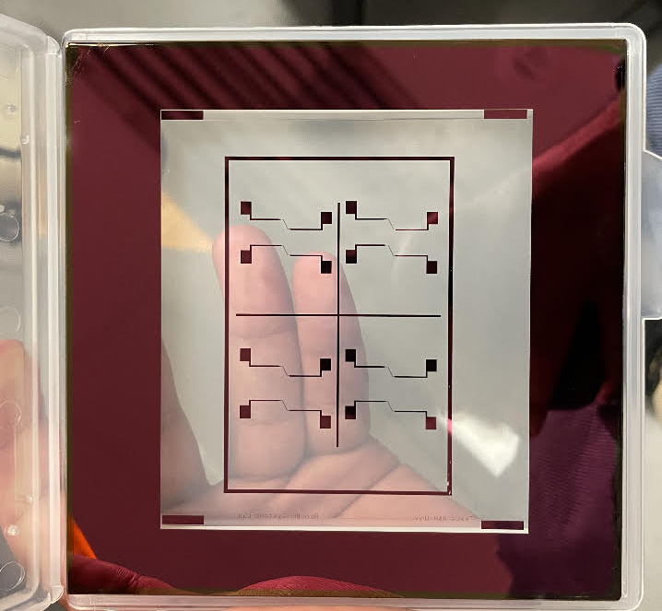
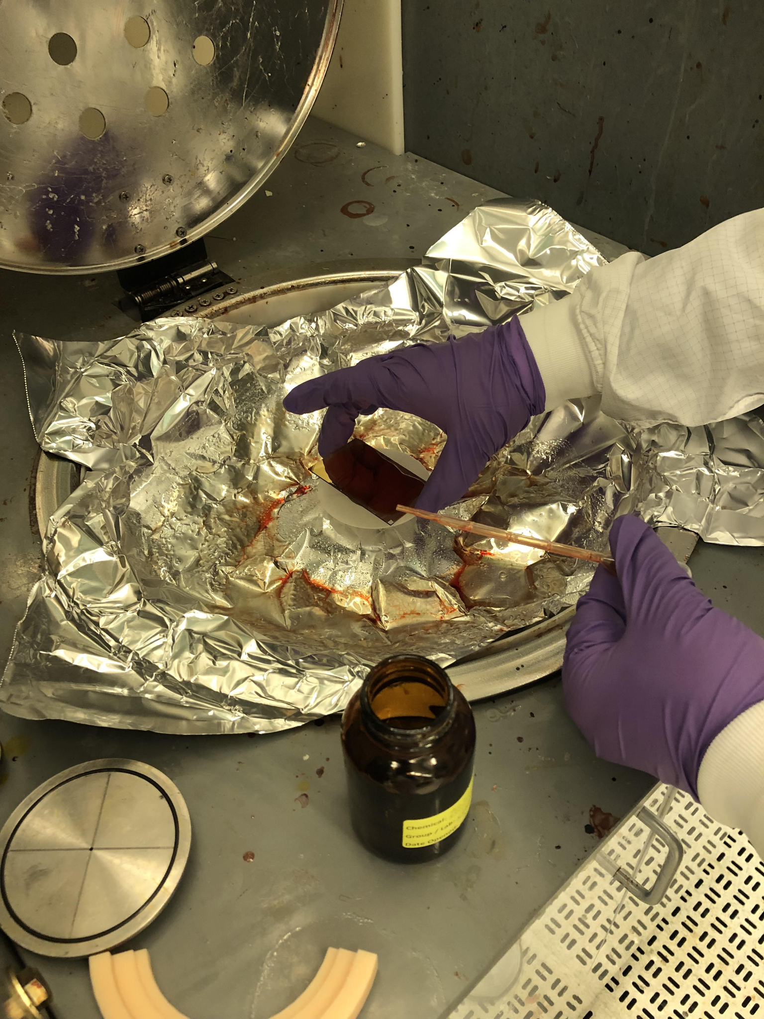
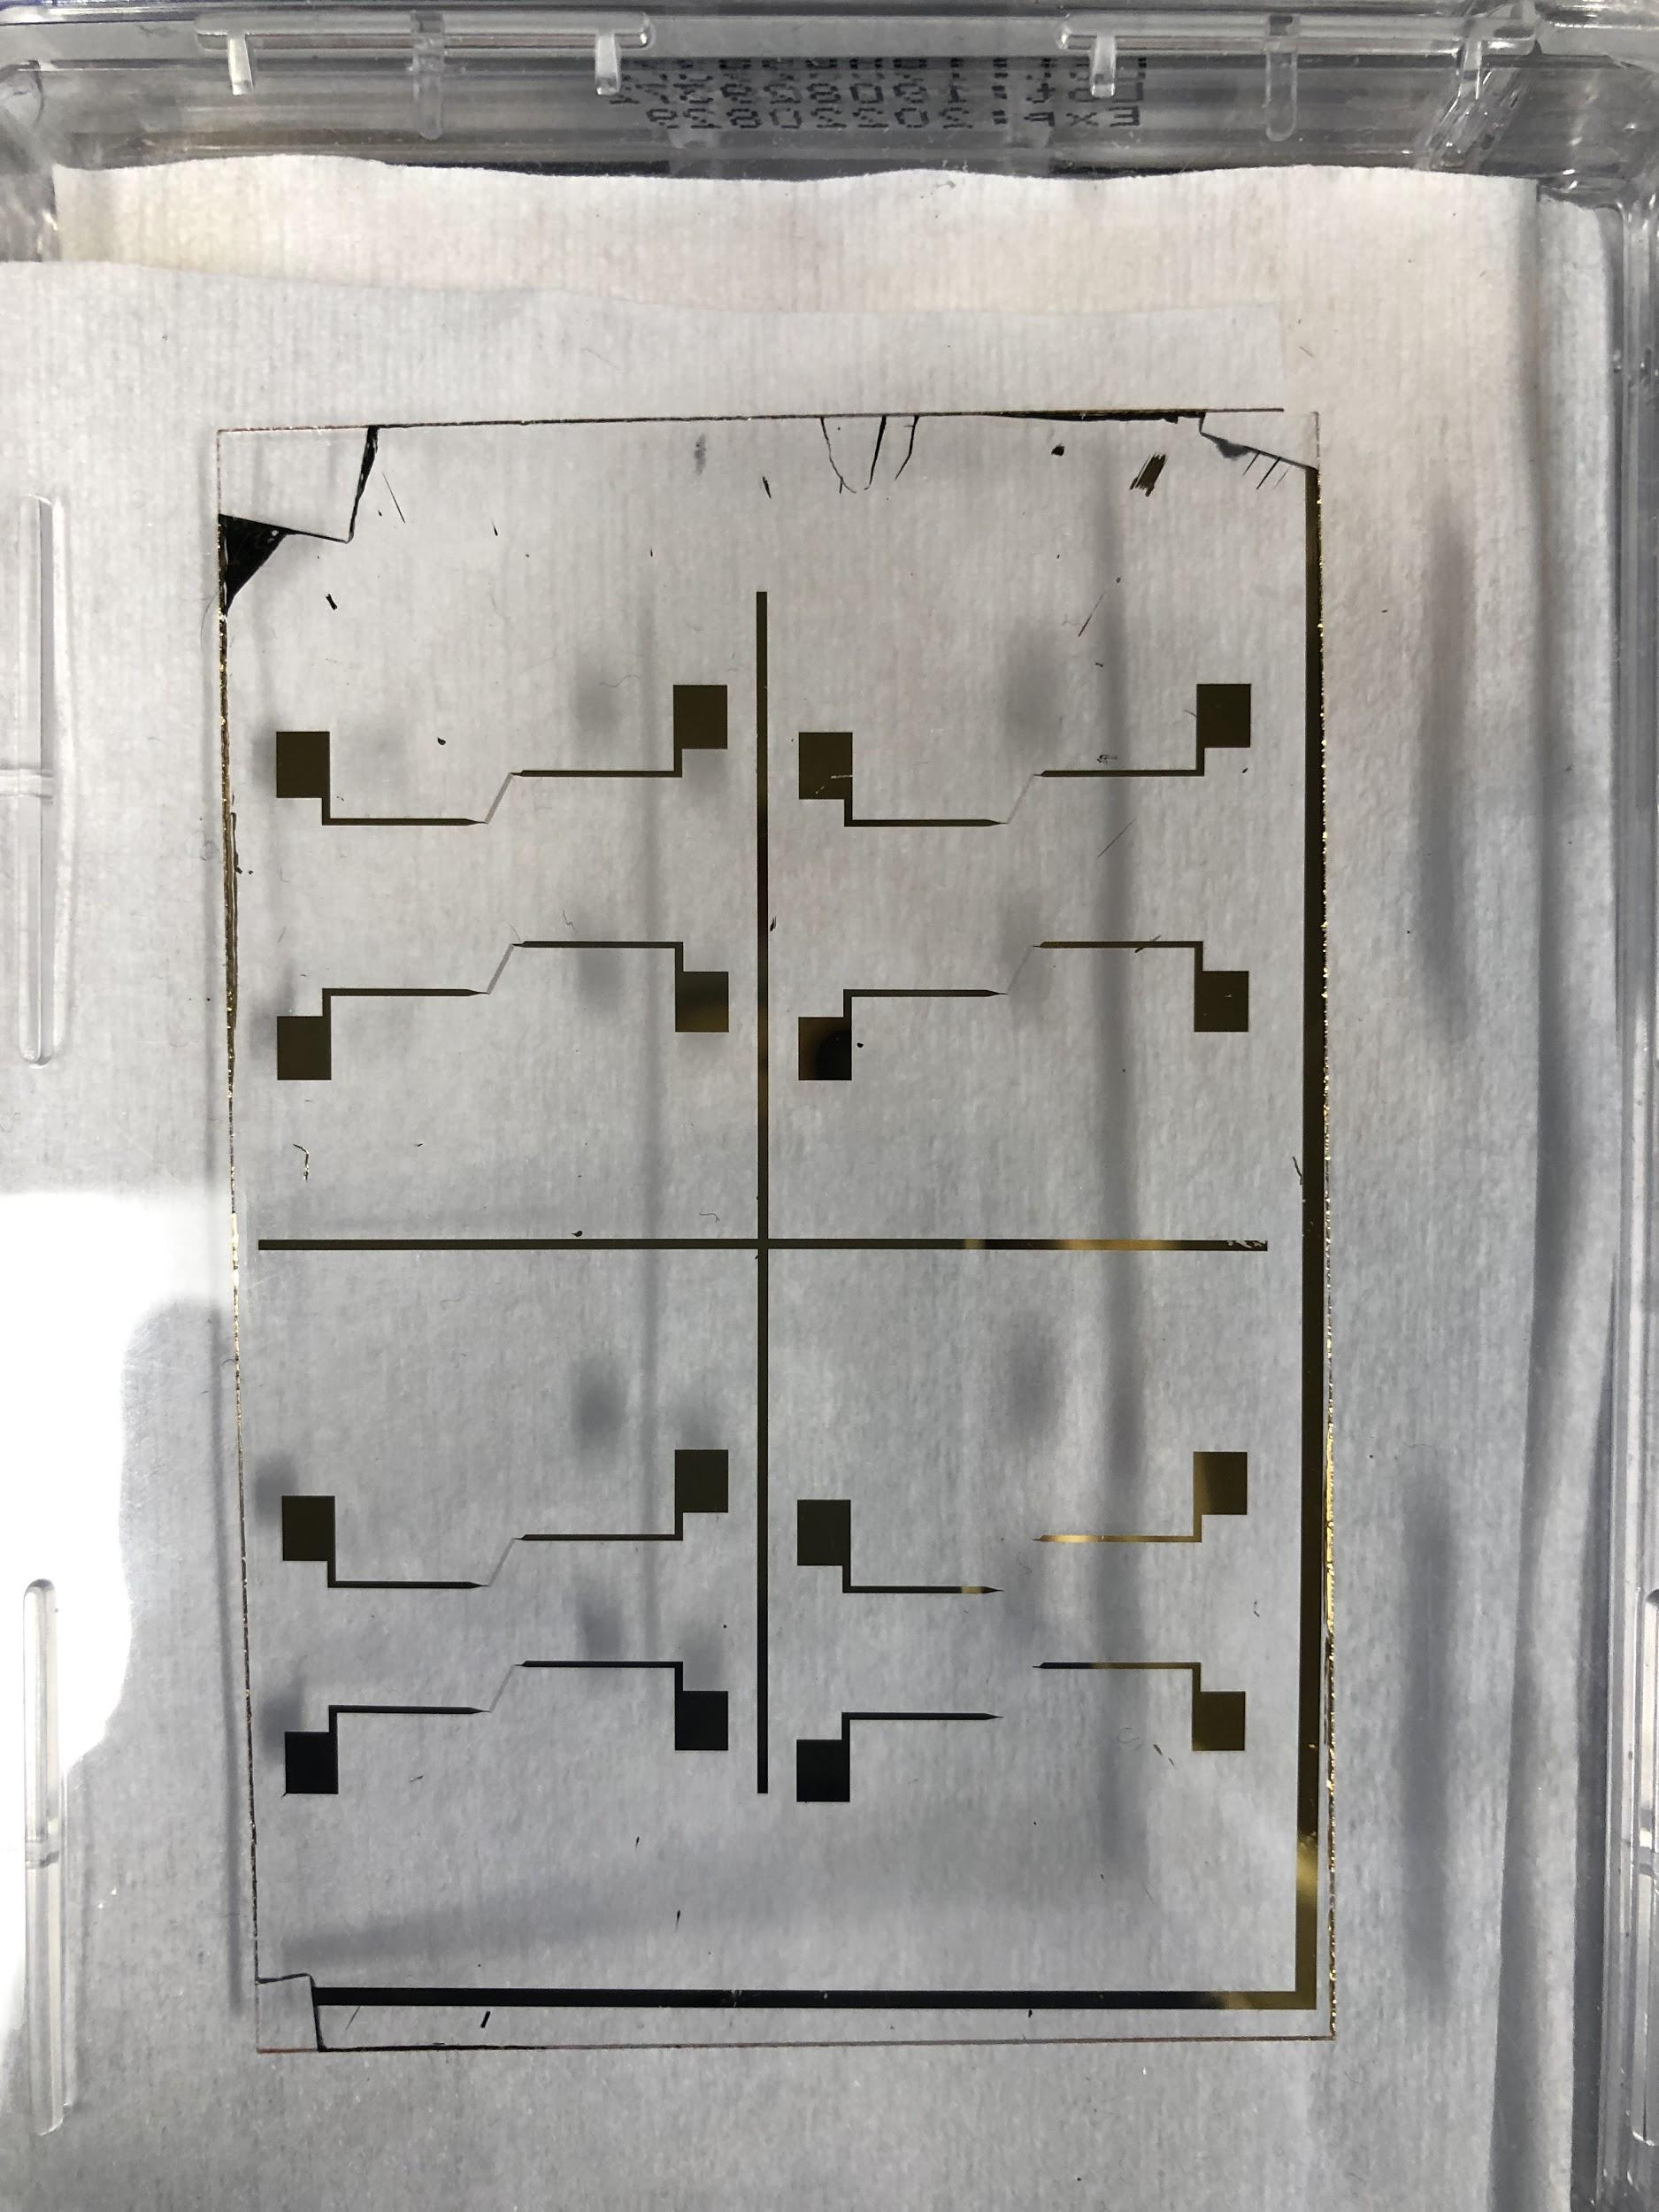
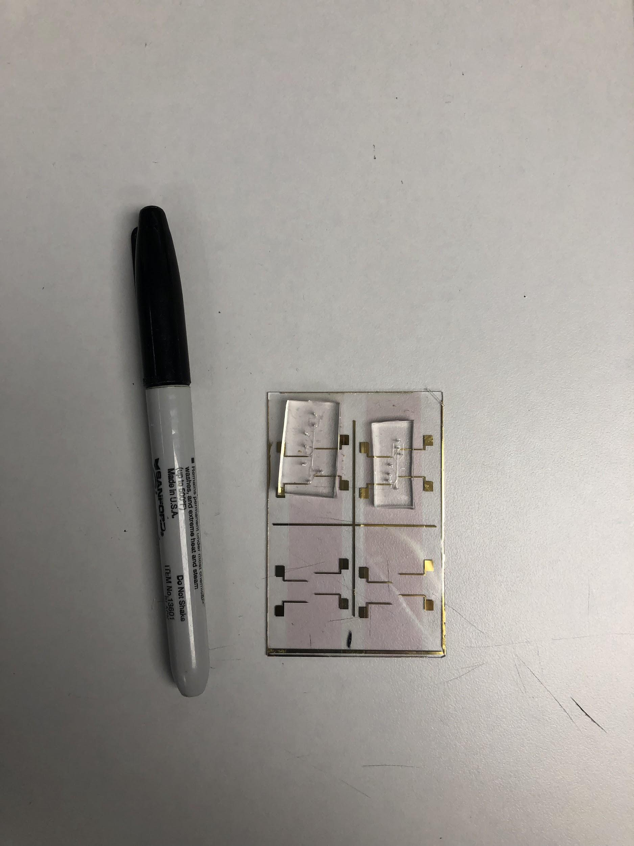
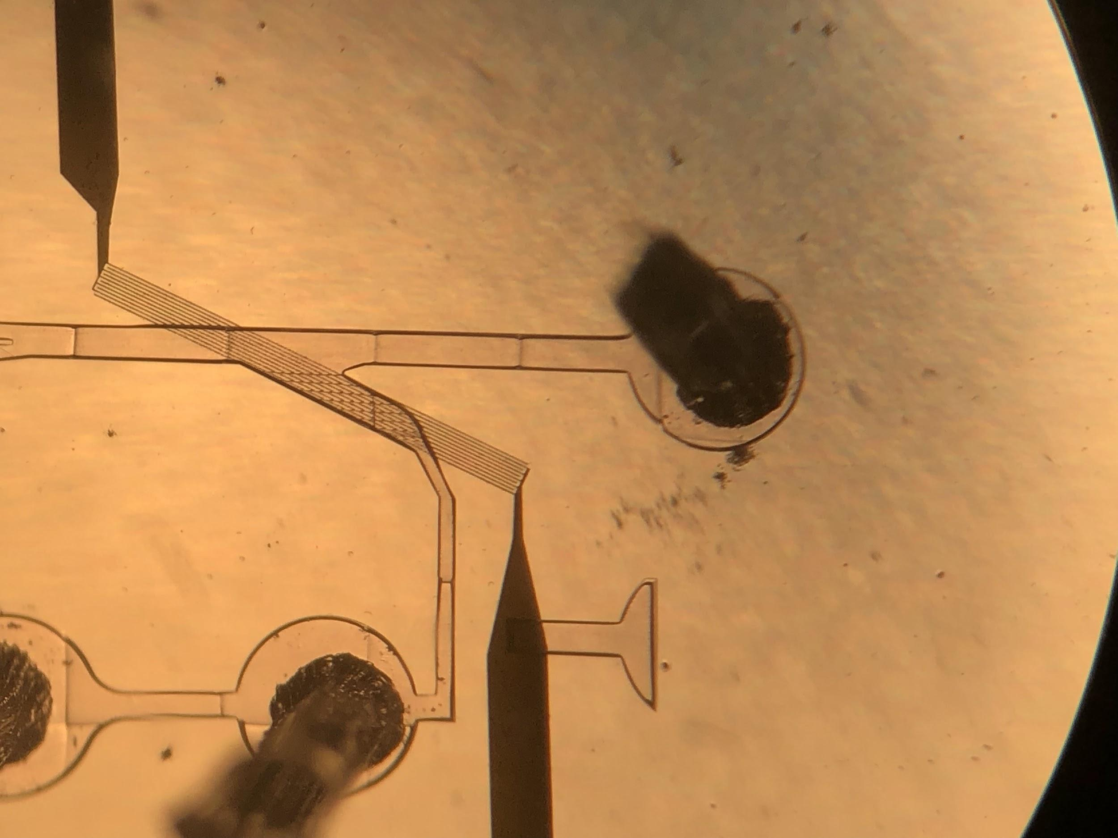
Fabrication Progress – IDE
IDE mask
Photolithography
Wet-etching
Alignment
Bonded device
Notes:
Omar

Slide 7
Accomplishments cont.
TESTING / VALIDATION | Omar (High-pass) | Erin (Band-pass)
Channel print quality (leaks, blockages) | ✅ | ✅
Droplet generation* | 404 | N/A
Fluid biasing | ✅ | ✅
IDE quality | ✅ | ✅
Filtration w/ IDE | In Progress | In Progress
*Droplet generation is not the focus of our innovation – filtration is.
Would be nice to have a built in droplet generator for ease of use, but not mandatory.
Notes:
Both

Slide 8
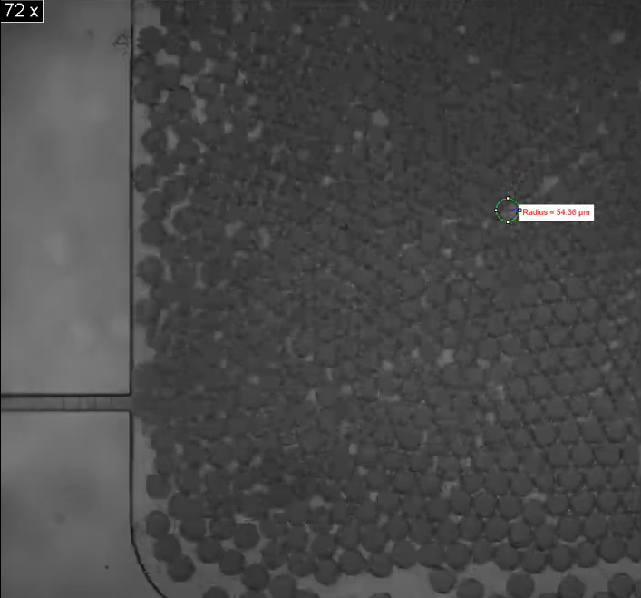
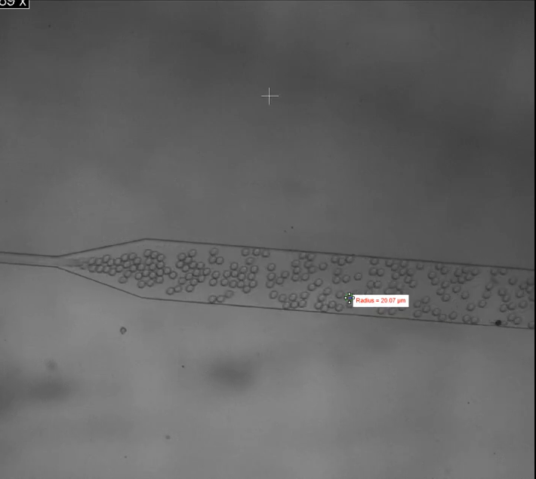
Validation Process - IDE filtration
Overview
Droplet generation of different sizes
Pass generated droplets into input on channels
IDE should filter based on sizes
Notes:
Omar
Many steps have to to be taken to reach experimenting on filtration – including having uniform droplet samples to input.
we generated these droplet samples and were planning to continue the experiment this week, however the government is hindering us.

Slide 9
Execution Plan
 | 9/16/22 | 9/30/22 | 10/14/22 | 10/28/22 | 11/11/22 | 11/25/22
High Pass Filter (Omar) | Train on non-cleanroom related tasks: -Soft-lithography -Plasma cleaner -Microscopes -PCR techniques | Design the channel, fabricate master mold using NanoScribe | Design IDEs Fabricate softlithography copies of channel | Finish droplet generation validation of Stage 1 (Moved to 404) Plasma bonding Train on metal deposition, photolithography, wet etching | COMSOL simulations complete Perform experiments using the bonded device Experiment with different IDE characteristics (Moved to 404) | Validate high pass filtration
Band Pass Filter (Erin) | Train on non-cleanroom related tasks: -Soft-lithography -Plasma cleaner -Microscopes -PCR techniques | Design the channel, fabricate master mold using NanoScribe | Design IDEs Plasma bonding training COMSOL training | Microscope/high speed camera training Train on metal deposition, photolithography, wet etching Plasma bonding | COMSOL simulations complete Fabricate softlithography copies of channel Perform experiments using the bonded device Experiment with different IDE characteristics (Moved to 404) | Validate band pass filtration
Notes:
Both

Slide 10

Remaining Tasks
Validation of filtration
Droplets have been generated ✅
Find optimum flow rate and related parameters to conduct experiment ✅
Apply ~200mV sine wave to IDE
Compare output with non-IDE output
404
Test different IDE parameters
Finger width/distance
Incorporate both designs with PCR
Report on findings in a paper
Notes:
Omar

Slide 11
Thanks! Questions?

